Slide 1


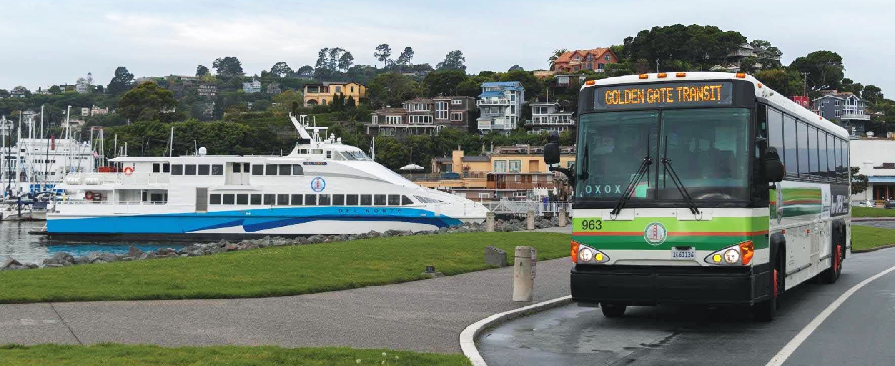
The Presentation
Experience
Expertise
Value
Innovation
Leadership
The Subtitle of the presentation
MAXIMO STRATEGIC PLANNING
BY JFC & ASSOCIATES / March 16, 2020
www.jfc-associates.com

Slide 2
Agenda
Executive Summary
Acknowledgements
State Of Asset Management
Discovery Period
KPIs & Reporting
Recommendations
Priority Log
The Path Forward

Slide 3
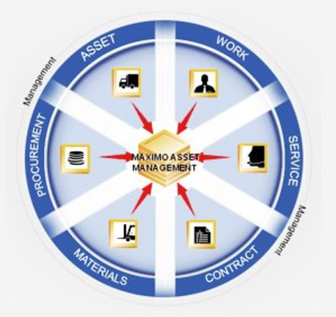
Executive Summary
The IBM Maximo Strategic Roadmap Plan (Plan) 2020-2025 is intended to provide help in decision-making across the organization and provide alignment between organizational and asset management objectives. It takes a long-term view, and considers the combination of organization needs, stakeholder expectations, and the realities of existing assets and asset management capabilities.
3

Slide 4
Acknowledgements
Bridge
Procurement
Capital & Grants
Accounting
Risk Management & Safety
Bus
Ferry
IS
Collaboration
Feedback Sessions
Document Discovery
Onsite Focus Groups
Thank
You
4

Slide 5
Agenda
Executive Summary
Acknowledgements
State Of Asset Management
Discovery Period
KPIs & Reporting
Recommendations
Priority Log
The Path Forward

Slide 6
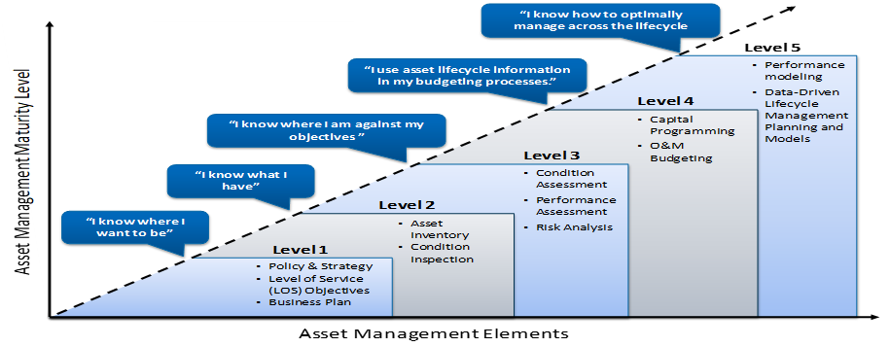
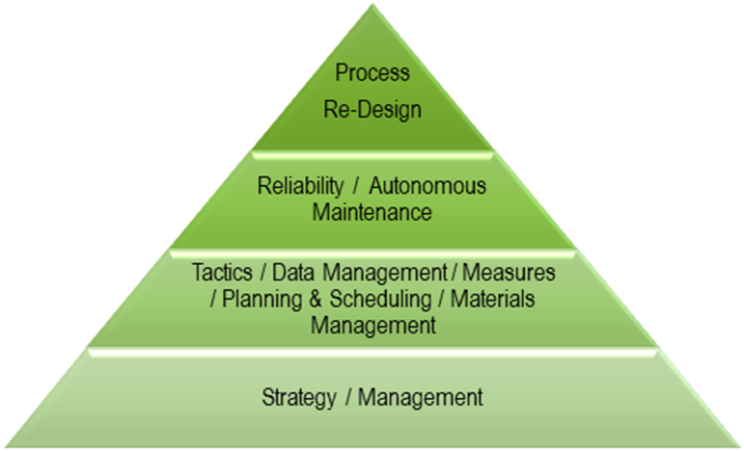
State of Asset Management
State of Asset Management
Overall Approach – Asset Management Primer
Asset Management Pyramid of Excellence
Organizational Maturity
6

Slide 7
Agenda
Executive Summary
Acknowledgements
State Of Asset Management
Discovery Period
KPIs & Reporting
Recommendations
Priority Log
The Path Forward

Slide 8
Discovery Period
How Did We Learn?
Reviewing Golden Gate Documents
Onsite Focus Groups
Division Meetings
Review Process
What is happening with Maximo?
Why is it Important?
8

Slide 9
Discovery Period
System Stability
Poor performance, Infrastructure issues
External Systems
Errors in data transfers, Discrepancy between systems
Inspections
Mobility
Move paper based inspections to Maximo
Increase and improve mobile functionality
Focus on Improvements
Efficiency
Trend Analysis
Availability
9

Slide 10
Discovery Period
User Interface
Errors, usability, operational issues
Reporting
Lack of data, inconsistency in information
Training & SOPs
Safety & Risk Management
Lack of documentation, standards, and learning resources
Need to track safety, permits, and regulations
Ease of Use
Decision Making
Empower Users
Compliance
10

Slide 11
Discovery Period
Additional Department Needs
Bridge
Maximo for the Bridge
Maximo for Stores
Maximo for Facilities
Maximo for Rolling Stock
IS
Maximo Environment
Streamlined Support
Knowledge Base
Economic Analysis & Forecasting
C&G
11

Slide 12
Discovery Period
Additional Department Needs Continued
Bus
Bus Inspections
Service Requests
Ferry
Ferry Inventory
Support
Maximo Applications
Operational Reports
Workflow and Business Process
Procurement
12

Slide 13
Agenda
Executive Summary
Acknowledgements
State Of Asset Management
Discovery Period
KPIs & Reporting
Recommendations
Priority Log
The Path Forward

Slide 14
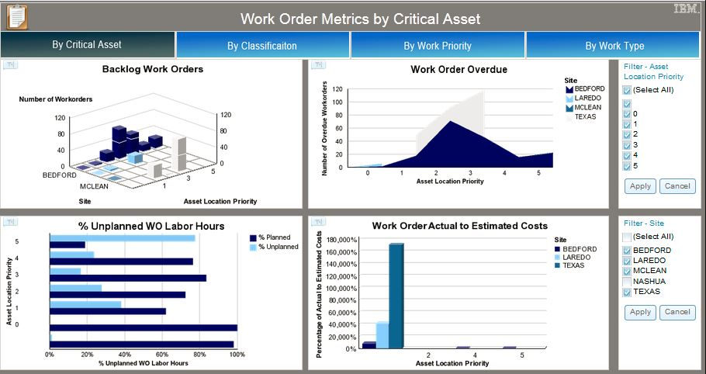
KPI’s & Reporting
Asset Performance Management (APM)
Strategic Dashboard: Focused on management and is geared toward Executives, and senior staff.
Tactical Dashboard: Provides analysis and is for managers and analysts.
Operational Dashboard: Monitors the business and is for front-line workers and supervisors
14
Notes:
Why Dashboards?
Criticality of establishing benchmarks in the beginning to set what data is being captured

Slide 15
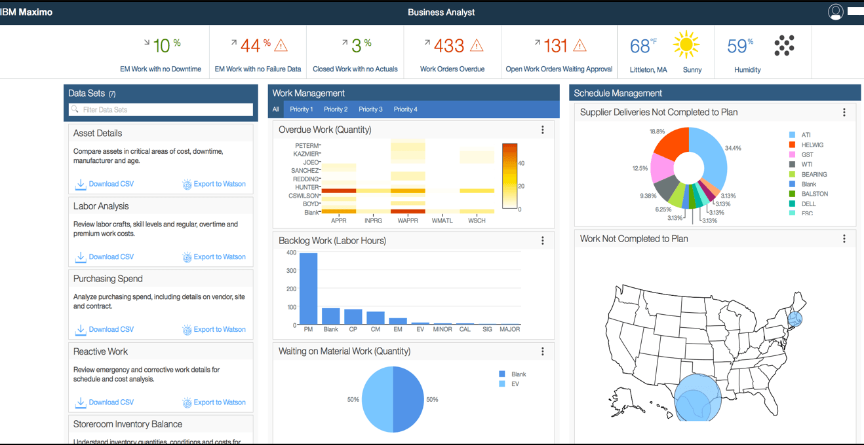
KPI’s & Reporting
Work Identification
Percentage of work requests in ‘Request’ status for less than 5 days
Percentage of man-hours used for proactive work
Work Planning
Percentage of work orders with man-hour estimates
Percentage of work orders in ‘rework’
Work Scheduling
Percentage of scheduled man-hours to total man-hours
Work Execution
Percentage of work orders completed before the required-by date
Percentage of work orders with all data fields completed
Cost
Maintenance cost divided by replacement asset value of plant and equipment
Failures
Mean time between failures
Failure frequency
15

Slide 16
Agenda
Executive Summary
Acknowledgements
State Of Asset Management
Discovery Period
KPIs & Reporting
Recommendations
Priority Log
The Path Forward

Slide 17
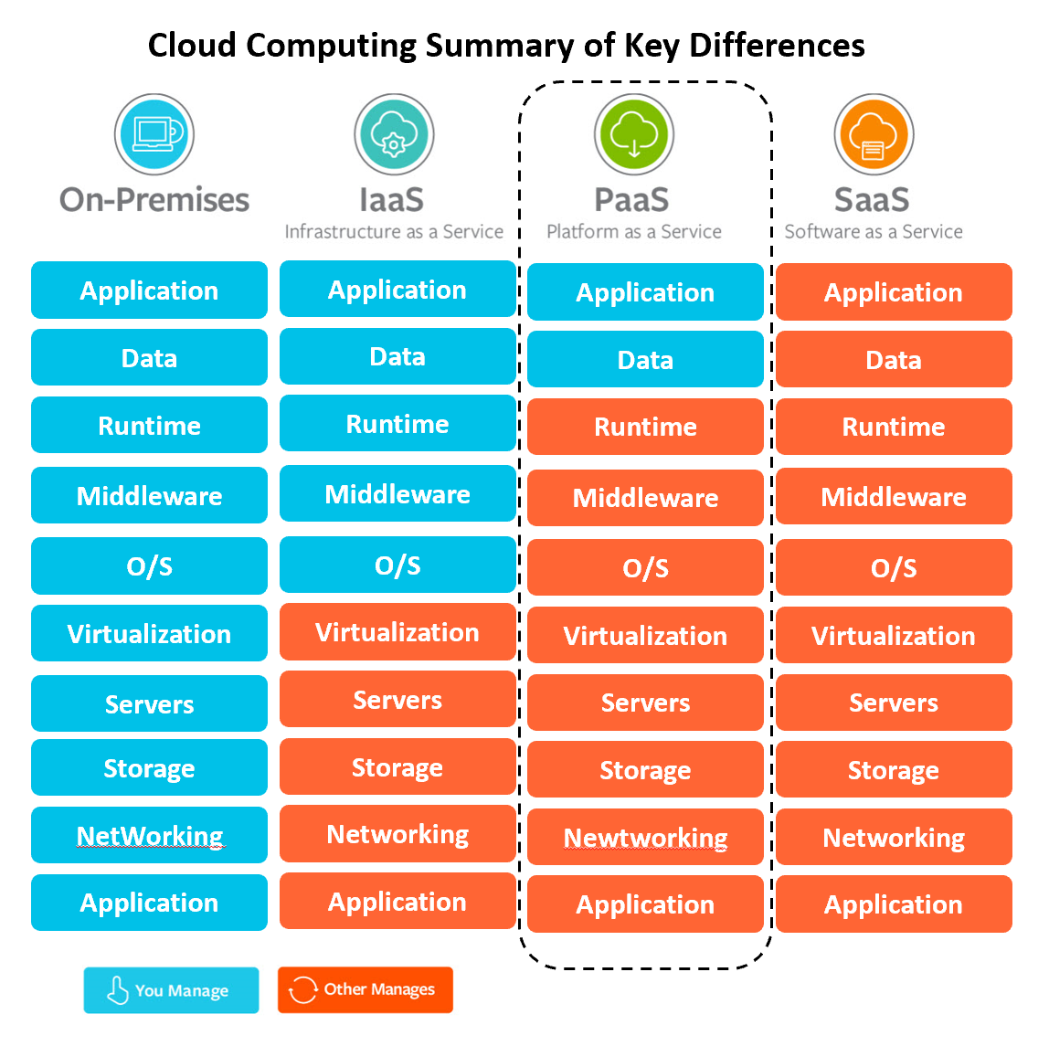
Recommendations
System Stability and Viability
IS Metrics
Maximo Uptime
Ticket first response time
Ticket Volume including issues vs. enhancements
Ticket Resolution Time by type
Ticket Backlog
Overall Customer Satisfaction for Maximo Support
17

Slide 18
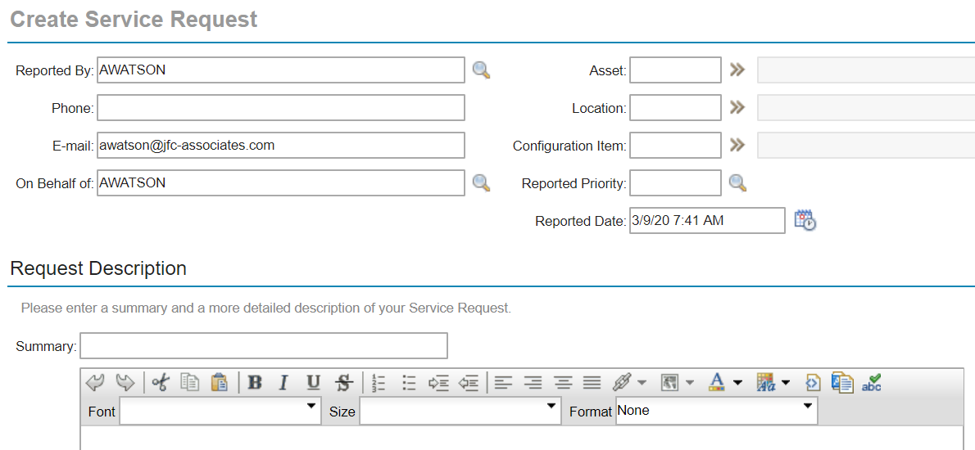
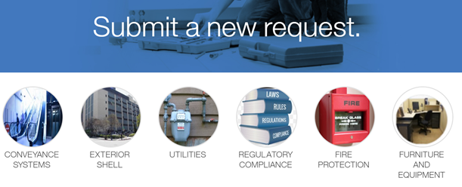
Recommendations
Short Term Priorities
Maximo Upgrade to 7.6.1
Leverage Features of the new version
Resolve the highest priority tactical issues
Remove customizations
Long Term Priorities
System Stability
Standardization of Operating Procedures
Institutional Knowledge & Training
Expanding Maximo Use and Applications
Improving Data Quality
Data & Analysis to Drive Business Decisions
18

Slide 19
Recommendations
2020 Projects
Maximo Platform & Hosting: Move off of Central Square hosting platform
Maximo 7.6.1 Upgrade: Maximo upgrade to version 7.6.1
DataSplice Upgrade & Enhancements: DataSplice upgrade and configuration
Bridge RFP: Bridge RFP for all or some of the Bridge implementation initiatives
Remove Rules Manager: Uninstall Rules Manager and move functionality to Maximo
High Priority Fixes: First pass of high priority fixes from the issue log
Oracle to MS SQL: Back end database migration from Oracle to Microsoft SQL Server
2021 Projects
7.6.1 Training, Documentation & SOPs: Ongoing effort to standardization and inform
Reporting, KPIs & Cognos Phase 1: First phase of Cognos, BIRT, KPIs, and dashboards
Maximo for the Bridge: Most important of the Bridge phased implementation
Maximo Fixes and Features Phase 2: Second phase 2 of fixes and enhancements
Classifications for Assets & Items: Ongoing project to leverage groupings in Maximo
Health Safety & Environment (HSE) Implementation: HSE add-on installation
Data Improvements (Inventory, Silos): Improving data quality in Maximo
Strategic Review: Year end review of progress toward short and long term objectives
19

Slide 20
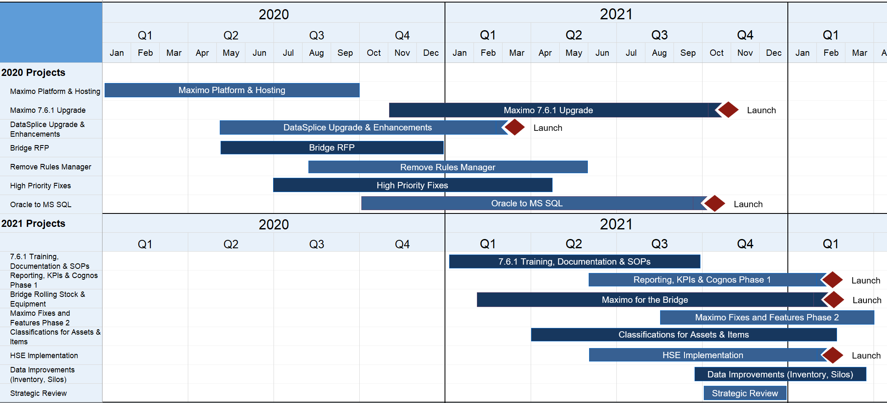
Recommendations
20

Slide 21
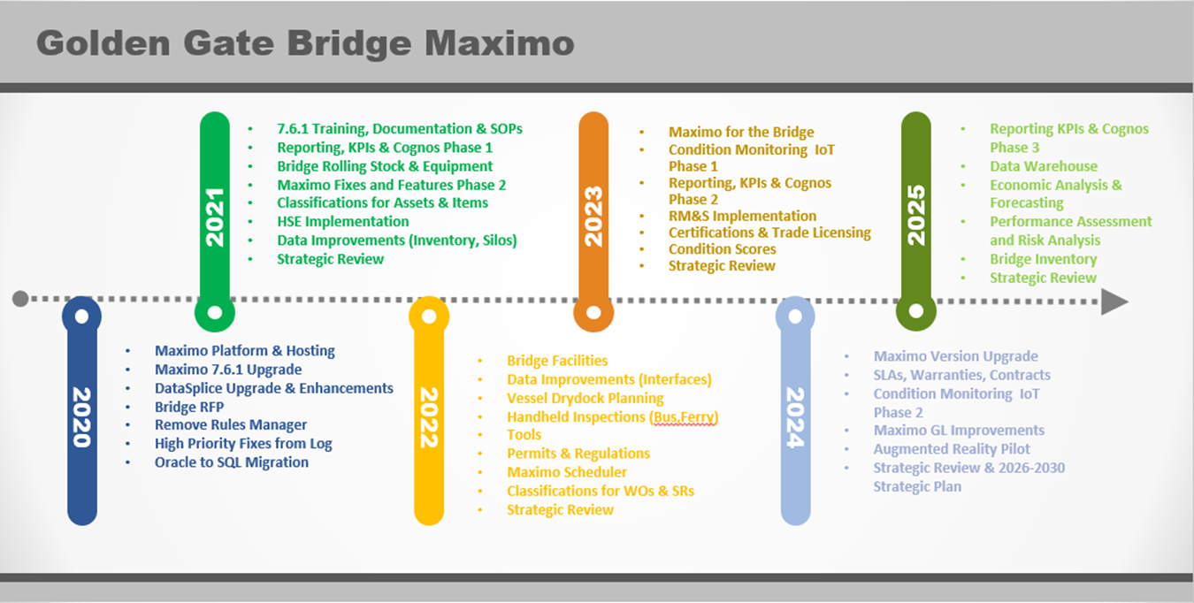
Recommendations
21
Notes:
Disticnct projects that have launch dates
Ongoing efforts like fixes
Gantt slot based on prioritization

Slide 22
Recommendations
2022 Projects
Bridge Rolling Stock & Equipment: 2nd priority for Bridge Implementation
Data Improvements (Interfaces): Reworking the interfaces with external systems
Vessel Drydock Planning: Maximo use in the shipyard for Ferry
Handheld Inspections (Bus, Ferry): Inspections on a mobile device and uploaded to Maximo
Tools: Leveraging tools and stocked tools applications in Maximo
Permits & Regulations: Rollout Permits and Regulations applications in Maximo
Maximo Scheduler: Scheduling tool for Ferry
Classifications for WOs & SRs: Classifying Work Orders and Service Requests by grouping like problems
Strategic Review: This is the second yearly review for progress on the strategic plan.
2023 Projects
Bridge Facilities: Expanding the PM program to additional assets and locations.
Condition Monitoring IoT Phase 1: Collecting meter reading data through inspections and IoT devices
Reporting, KPIs & Cognos Phase 2: Leverage data quality improvement and expand dashboards
RM&S Implementation: Department implementation of Maximo
Certifications & Trade Licensing: Qualifications and certification tracking
Condition Scores: Generate condition scores in Maximo
Strategic Review: This is the third annual review of Strategic Plan progress.
22

Slide 23
Recommendations
2024 Projects
Maximo Version Upgrade: GGB should plan on a major Maximo upgrade every 3-4 years
SLAs, Warranties, Contracts: Adding use of these applications in Maximo (or ERP)
Condition Monitoring IoT Phase 2: Capturing additional areas for condition monitoring
Maximo GL Improvements: Adding GL account information for more specific tracking on maintenance spending
Augmented Reality Pilot: A pilot to look at 3D models for engineers
Strategic Review & 2026-2030 Strategic Plan: Long-term planning process for the next 5 years
2025 Projects
Reporting KPIs & Cognos Phase 3: Consolidated analytical reports, risk analysis, and economic forecasting
Data Warehouse: Consolidate data from multiple systems into a single source
Economic Analysis & Forecasting: Leverage data quality improvements and upgraded interfaces to perform economic analysis
Performance Assessment and Risk Analysis: Thorough analysis of all assets under management
Bridge Inventory: The final initiative for the Bridge; satellite storerooms
Strategic Review: Overall performance of the 5 year plan and objectives
23

Slide 24
Agenda
Executive Summary
Acknowledgements
State Of Asset Management
Discovery Period
KPIs & Reporting
Recommendations
Priority Log
The Path Forward

Slide 25
Priority Log By Department
Tactical issues
25

Slide 26
The Path Forward
Forecasting & Analysis
Continuous Improvement
Documentation & Standardization
System Stability
26

Slide 27
The Path Forward
Commitment
Resources
Collaboration
Planning
Assessment
Factors for Success
27

Slide 28
OUR EMAIL
OUR WEBSITE
PHONE
jconnell@jfc-associates.com
www.jfc-associates.com
671.963.3590

